Slide 1
Dynamodb another nosql
M Du

Slide 2
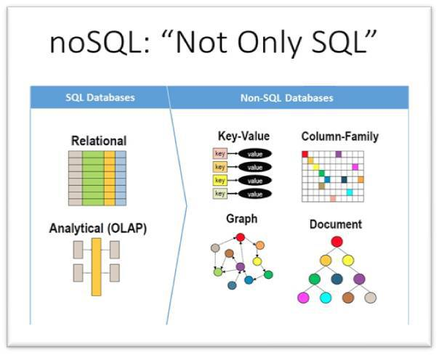

Slide 3
ProductID | type | title | publisher | label | Date Published | Date Released | ISBN
1 | Book | Some Book | Debbie Printhouse | NULL | 10/3/10 | NULL | 0-123-4958
2 | Album | Some Album | NULL | Joe Kash Money | NULL | 4/18/15 | NULL
Notes:
As many or as few attributes as you want

Slide 4
ProductID | type | title | publisher | label | Date Published | Date Released | ISBN | Length | Producer | Writer
1 | book | Some Book | Debbie Printhouse | NULL | 10/3/10 | NULL | 0-123-4958 | NULL | NULL | NULL
2 | album | Some Album | NULL | Joe Kash Money | NULL | 4/18/15 | NULL | NULL | NULL | NULL
3 | movie | Some Movie | NULL | NULL | NULL | 3/17/17 | NULL | 1hr30min | 40th Century Fox | Steven Spielberg

Slide 5
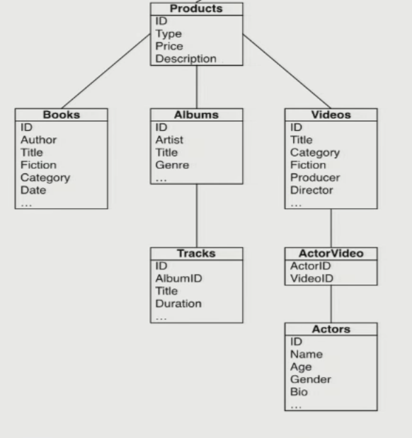

Slide 6
ProductID | type | title
 |  |  | publisher | Date Published | ISBN
1 | bookID | Some Book | Debbie Printhouse | 10/3/10 | 0-123-4958
 |  |  | label | Date Released
2 | albumID | Some Album | Joe Kash Money | 4/18/15
 |  |  | Date Released | Length | Producer | Writer
3 | movieID | Some Movie | 3/17/17 | 1hr30min | 40th Century Fox | Steven Spielberg

Slide 7
List, Dict, Set
ProductID | type | title | attributes
1 | book | Some Book | { "publisher": "Debbie Printhouse", "Date Published": "10/3/10", "ISBN": "0-123-4958" }
2 | album | Some Album | { "label": "Joe Kash Money", "Date Released": "4/18/15" }
3 | movie | Some Movie | { "Date Released": "3/17/17", "Length": "1hr30min", "Producer": "40th Century Fox", "Writer": "Steven Spielberg" }

Slide 8
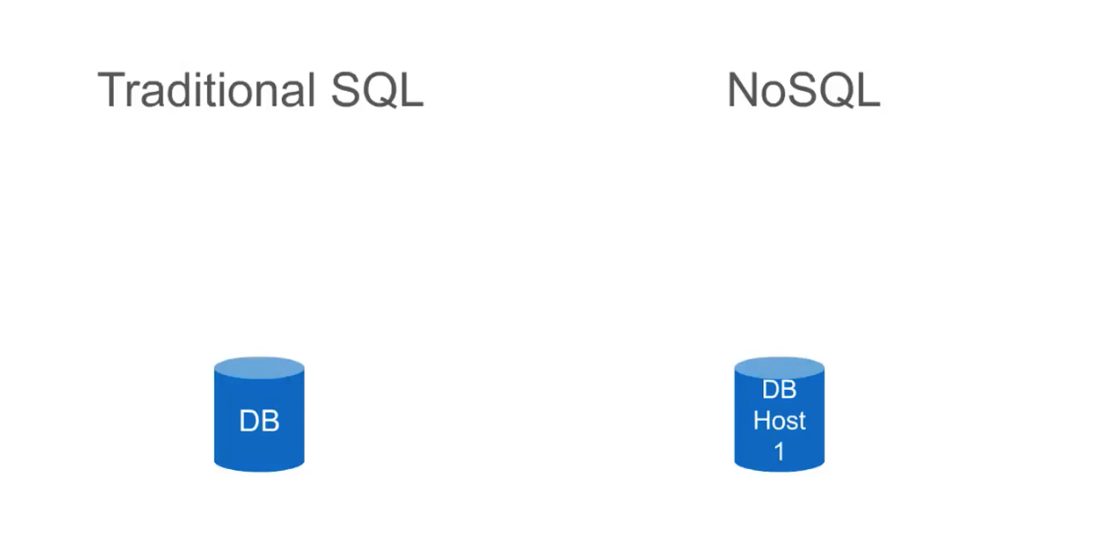
Scaling
Designed for massive scale on distributed systems meaning that they run on multiple servers that work together, each sharing part of the load.
Designed to run on a single server in order to maintain the integrity of the table mappings

Slide 9
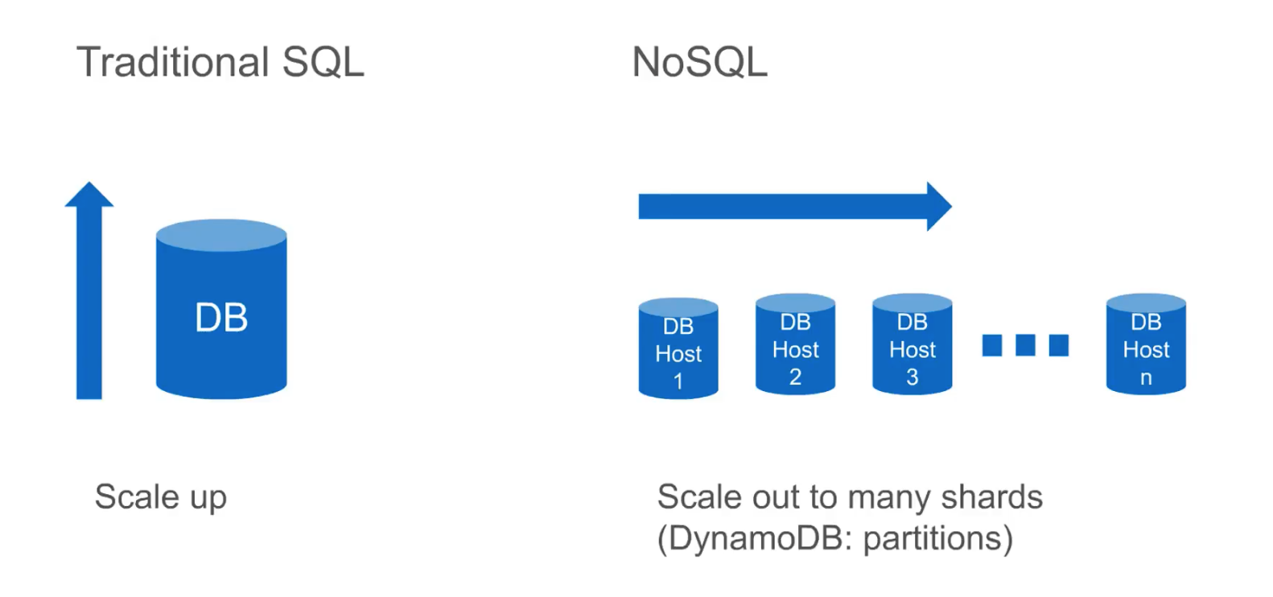
Scaling

Slide 10
Fast and efficient read/write
Working with schema-less JSON data that can be looked up against a single key or a key/range combination
Ideal for accruing data

Slide 11
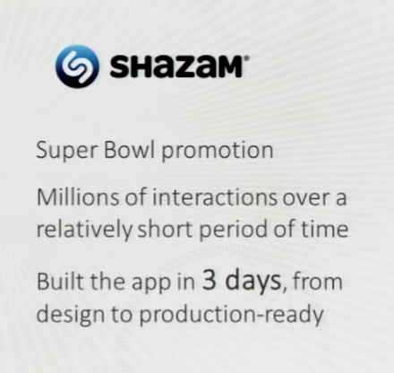
Ease of deployment

Slide 12
Cons
If data is well structured and has a predefined structure that isn’t subject to change
Require data manipulation
Ex. Identifying most popular product categories by average star ratings
Data can only be stored stored on AWS
AWS Dynamo SDK has steep learning curve

